Slide 1
Network Layer

Slide 2
Purpose
Network Layer concerned with getting packets from the source all the way to the destination.
In contrast to Data Link Layer.
Why so?

Slide 3
Prerequisites
Network Layer must :
Topology –
Network layer must know about the topology of the network
Appropriate Path –
Must choose appropriate path
Internetworking –
Network layer must be able to support communication between S and D belonging in 2 different networks

Slide 4
Network Layer Design Issues
Store-and-forward packet switching
Services provided to transport layer
Implementation of connectionless service
Implementation of connection-oriented service

Slide 5
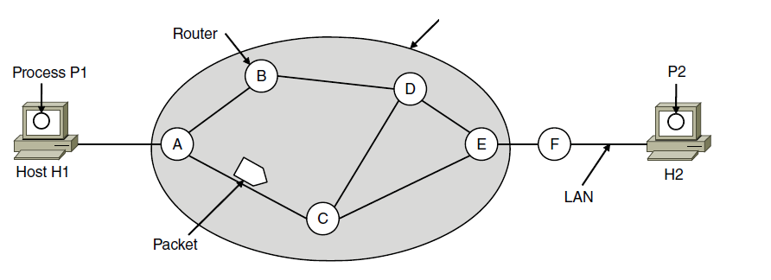
1) Store-and-Forward Packet Switching
ISP’s equipment
The packet is stored in the intermediate router(s) until it has fully arrived and the link has finished its processing by verifying the checksum.
Then it is forwarded to the next router along the path until it reaches the destination host, where it is delivered.

Slide 7
2) Services Provided to the Transport Layer
Goals for designing services:
Services independent of router technology.
Transport layer shielded from number, type, topology of routers.
Network addresses available to transport layer use uniform numbering plan

Slide 8
2) Services Provided to the Transport Layer
What are the Services ?
Connection Oriented
Connection Less

Slide 9
Connection Oriented vs Connection Less
Connection Less –
Internet Community
Network Unreliable
Hosts perform error control, flow control
Packets out of order
Each packet carry full destination address
Connection Oriented –
Telephone Companies
Network reliable

Slide 11
3) Implementation of Connectionless Service
Packets are injected into the network individually
Each packet routed independently
No advance set up
Data unit is termed as datagrams
Network is termed as datagram network

Slide 12
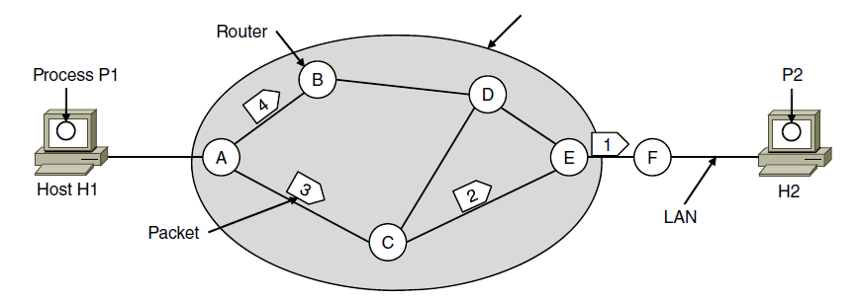
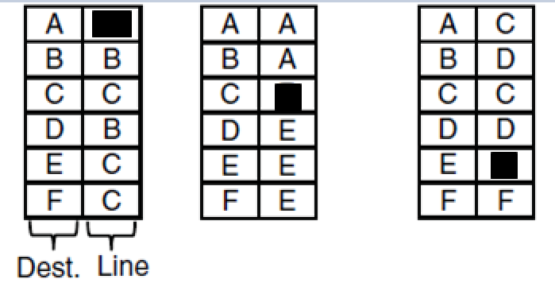
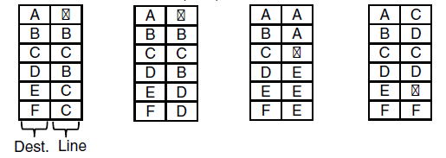
3) Implementation of Connectionless Service
A’s table (initially) C’s Table E’s Table
A’s table (later)
Source H1
Destination H2
Routing within a datagram network

Slide 13
Connectionless Example -
Number of datagrams to be sent = 4
Datagrams 1,2,3 follows path ACEF
For some reason, A decides to send datagram 4 via B
Routing Algorithms - manages the tables and makes the routing decisions

Slide 15
4) Implementation of Connection Oriented Service
Path from the source router all the way to the destination router must be established before any transmission
Avoids having to choose a new route for every packet sent
All packets follow the same path
Advance set up
Connection is termed as Virtual Circuit
Each packet carries an identifier telling which virtual circuit it belongs to.
Network is termed as virtual circuit network

Slide 16
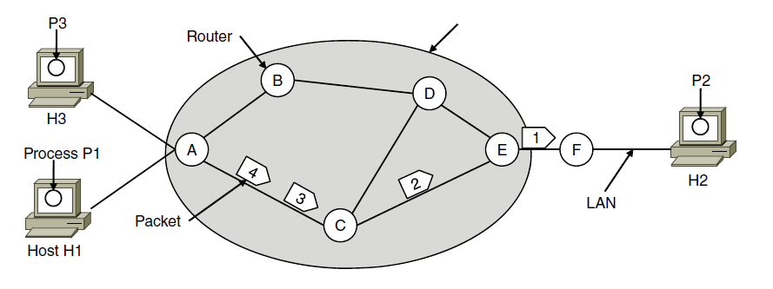

4) Implementation of Connection-Oriented Service
ISP’s equipment
A’s table C’s Table E’s Table
Source H1, Destination H2
Source H3, Destination H2
Routing within a virtual-circuit network

Slide 17
Connection Oriented Example -
Number of packets to be transmitted = 4
Host H1 has established connection with host H2
Connection identifer = 1
A’s initial entry if a packet bearing connection identifier 1 comes in from H1, it is to be sent to router C and given connection identifier 1
Similarly for the other routers
Host H3 has established connection 1 with host H2
H3 chooses connection identifier 1
But A alone can distinguish between the two circuits, so, for outgoing line changes connection identifier to 2
Label switching

Slide 19
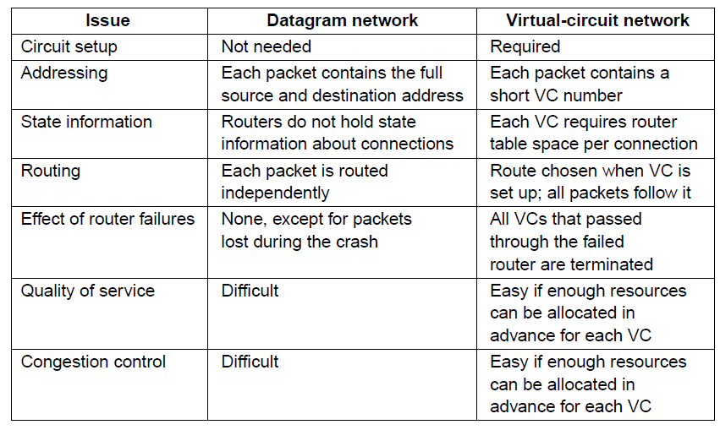
Comparison of Virtual-Circuit and Datagram Networks – pg 361 (5th ed)

Slide 20
Tradeoffs between virtual circuits and datagrams
Parameter | Virtual Circuits | Datagrams | Explanation
Time | Setup time | Address Parsing Time | Setting up circuits takes time and resources. Address Parsing Time - complicated lookup procedure is required to locate the entry for the destination.
Identification | Connection identifier | Destination Address | Destination addresses used in datagram networks are longer than circuit numbers used in virtual-circuit networks. If the packets tend to be fairly short, including a full destination address in every packet may represent a significant amount of overhead, and hence a waste of bandwidth

Slide 21
Parameter | Virtual Circuit | Datagram
Table Space | virtual-circuit network just needs an entry for each virtual circuit | datagram network needs to have an entry for every possible destination
QoS, Congestion | Guarantees QoS and avoid congestion. Resources reserved in advance | Congestion Avoidance Difficult
Vulnerability – router crashes | all the virtual circuits passing through it will have to be aborted. Fatal impact | only those users whose packets were queued in the router at the time need Suffer Easily compensated

